Slide 1


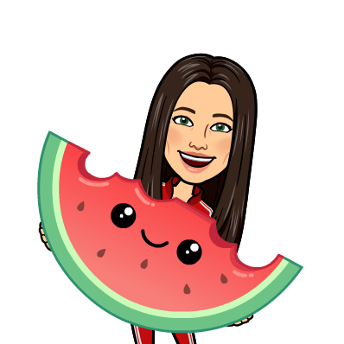




Fitly
CFG Group Project
Alexandra
Delia
Raghad
Regina
Yasmine

Slide 2
Agenda
Background to project
Demo & how it works
Top wins
Top challenges
Working as a team
Learnings for the future

Slide 3
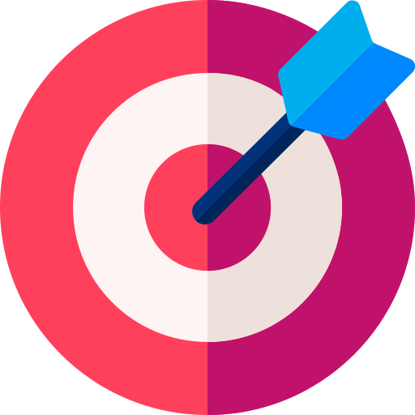

Aim: to use the knowledge gained from the CFG Software
Nanodegree to create a fitness workout generator
FITLY

Slide 4

FITLY

Slide 5




Introducing: Fitly
FITLY

Slide 6

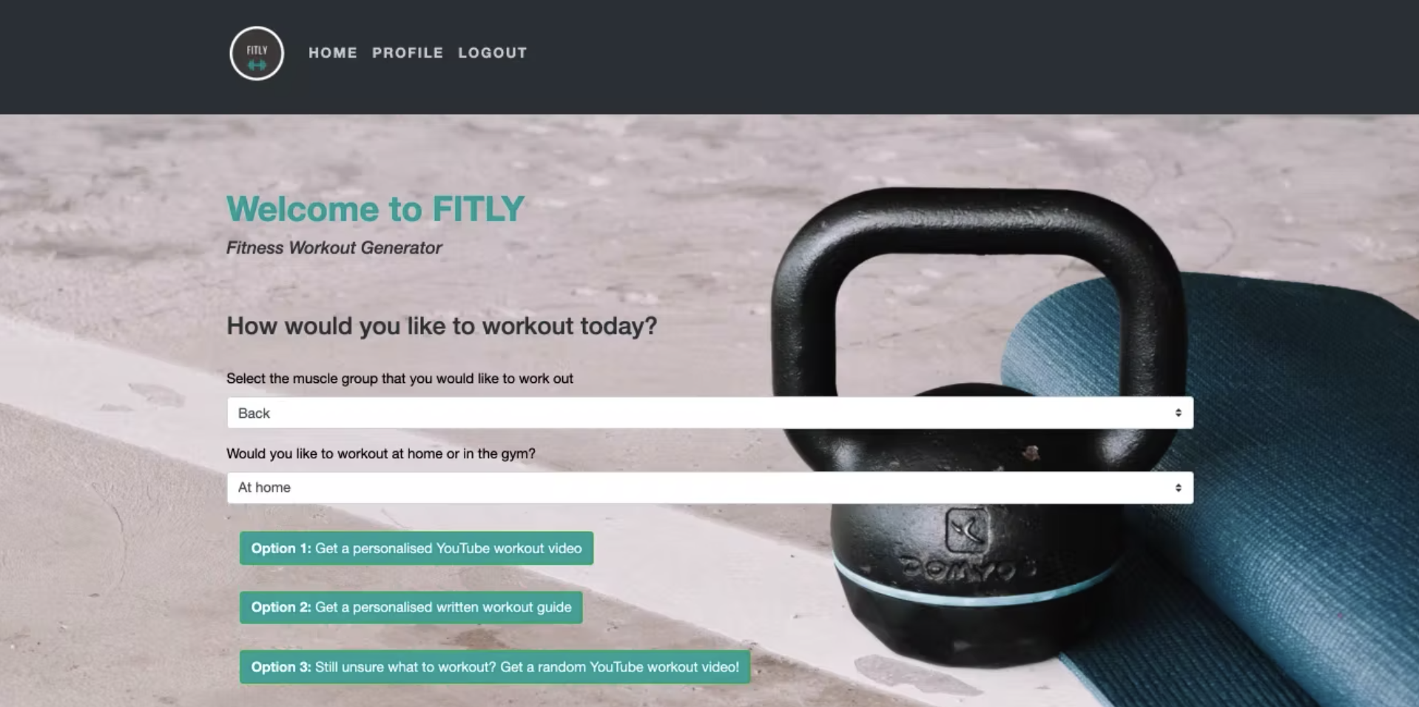
What is Fitly?
Web application
YouTube videos & written guides
Workouts based on:
Target muscle group
Home workout/gym workout
Integrates with two APIs:
GoogleClientAPI
Exercise DB API
Screenshot of the Fitly user interface

Slide 7
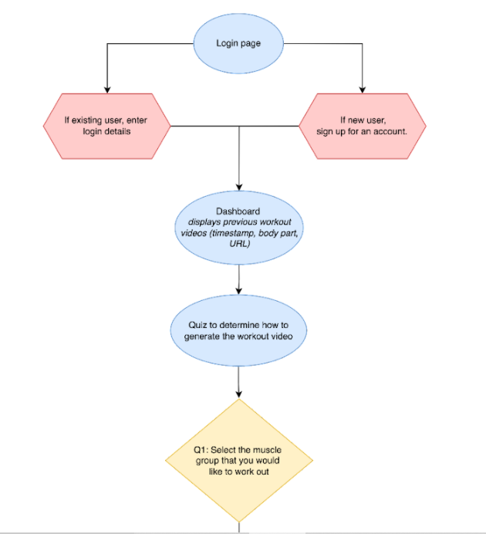
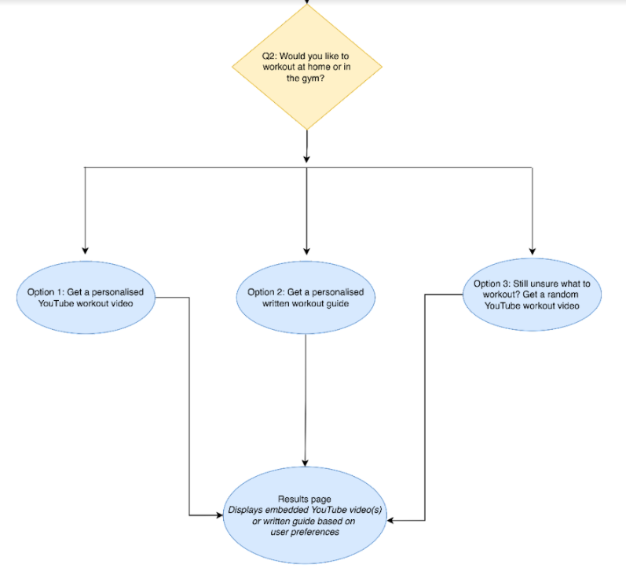
How does Fitly work?

Slide 8


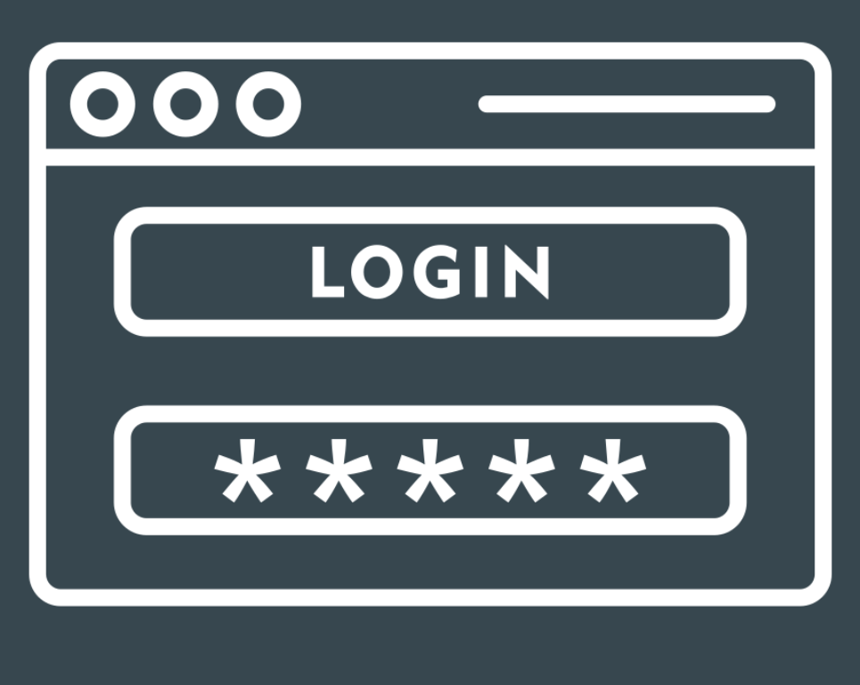
OUR TOP WINS
Many wins: Completing the project, User-friendly web application, working collaboratively in a remote setting.
Allowing complexity to the project
Applying both Python & SQL simultaneously
Implementing key aspects of software development
FITLY

Slide 9
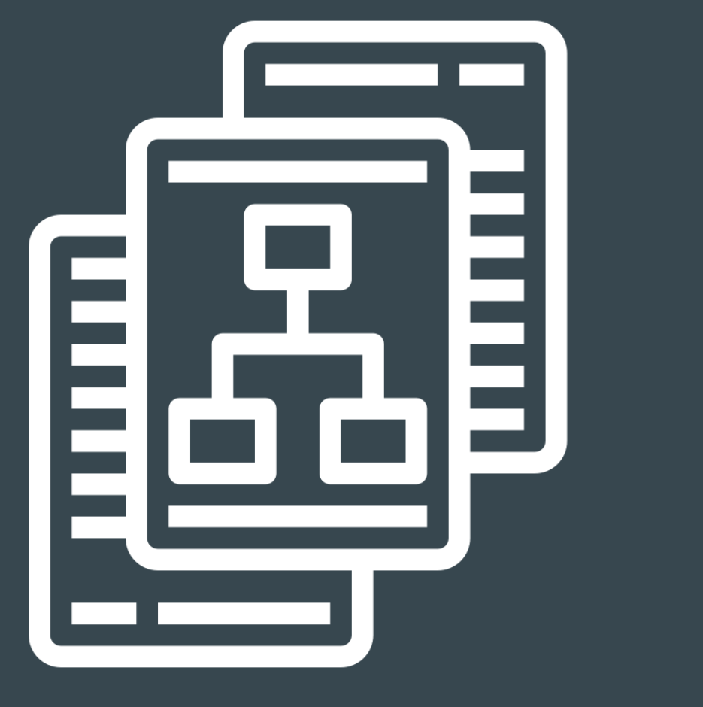



Our top challenges
Narrowing the scope of the project
Balancing ambition with skillset
Varied capacity in the team
Order of task completion
FITLY

Slide 10
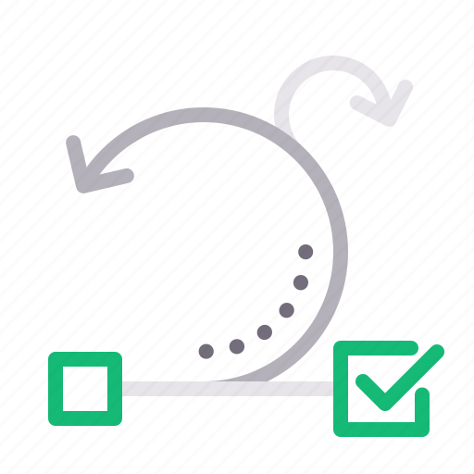



Working As A Team
Trello
Slack Check-Ins
Regular Meetings
Agile
FITLY

Slide 11



Our Learnings For Future
Additional Features
Artificial Intelligence
Additional Collaboration
FITLY

Slide 12
In summary…
FITLY

Slide 13
THANK YOU FOR LISTENING
FITLY

